Slide 1


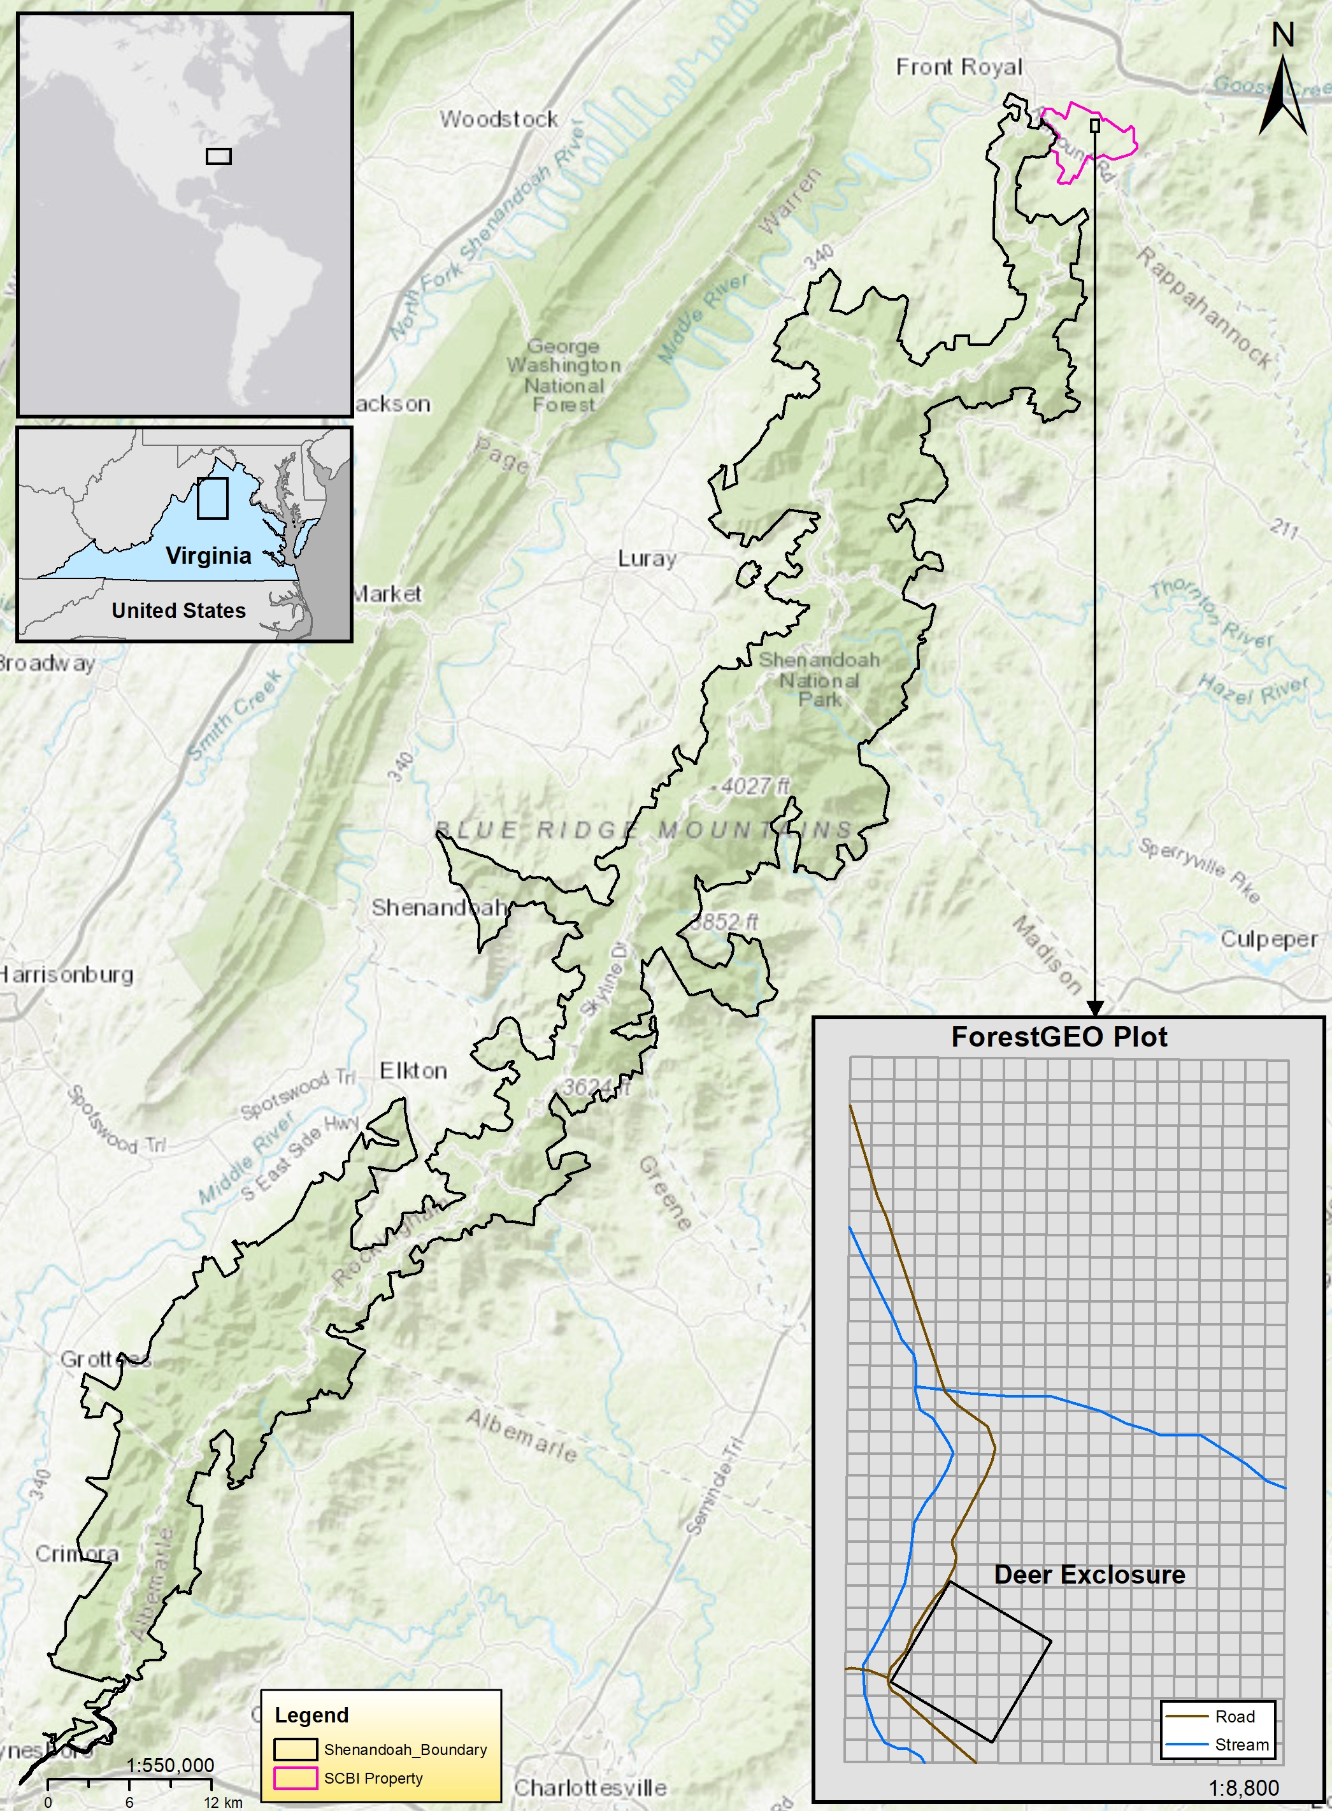
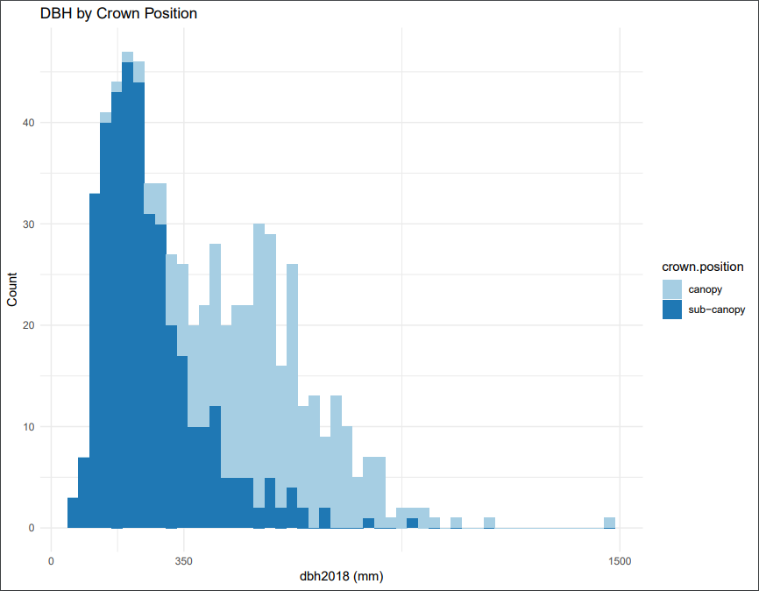
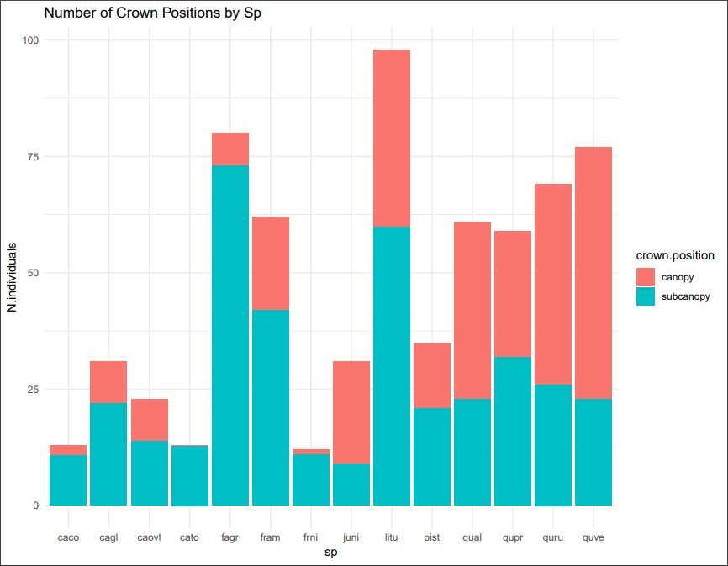
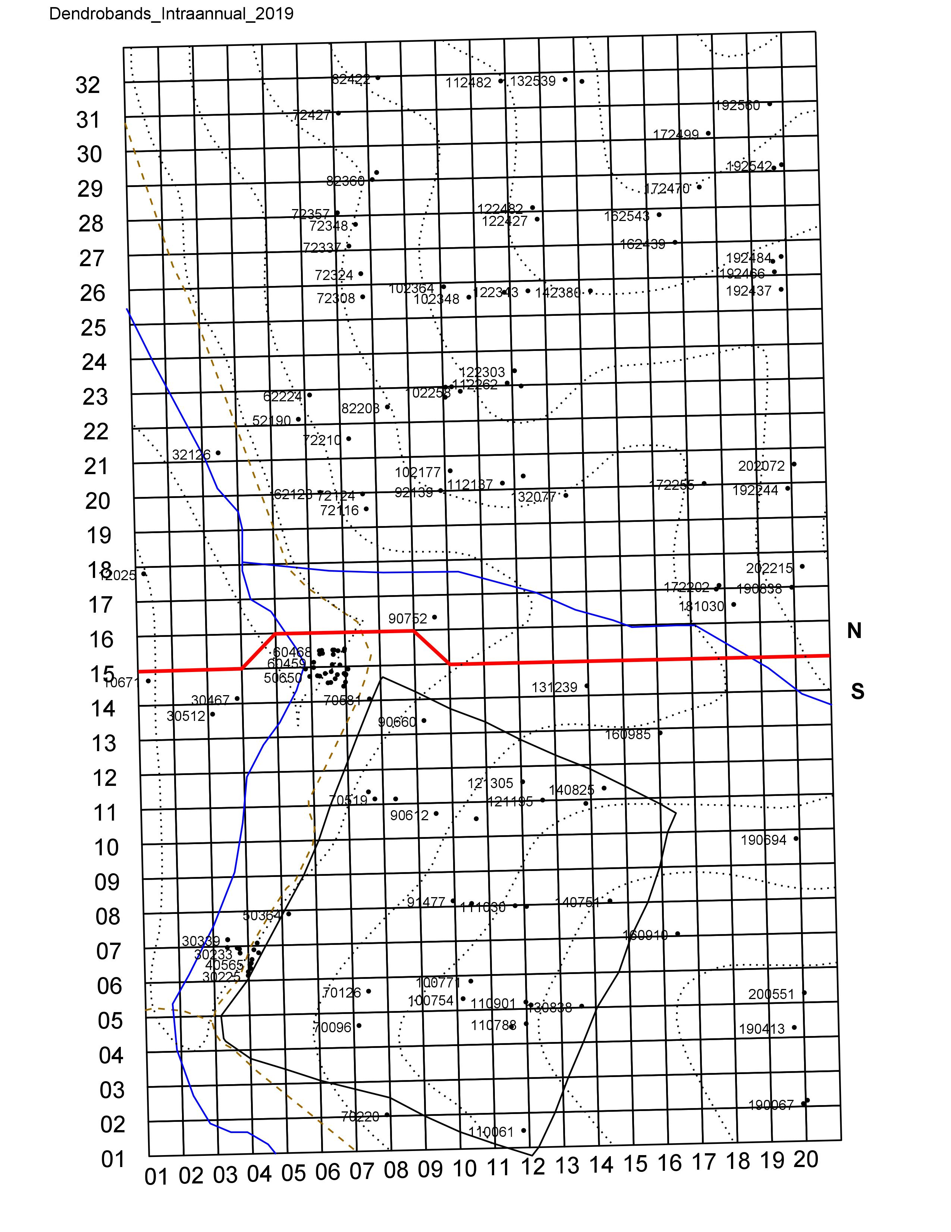
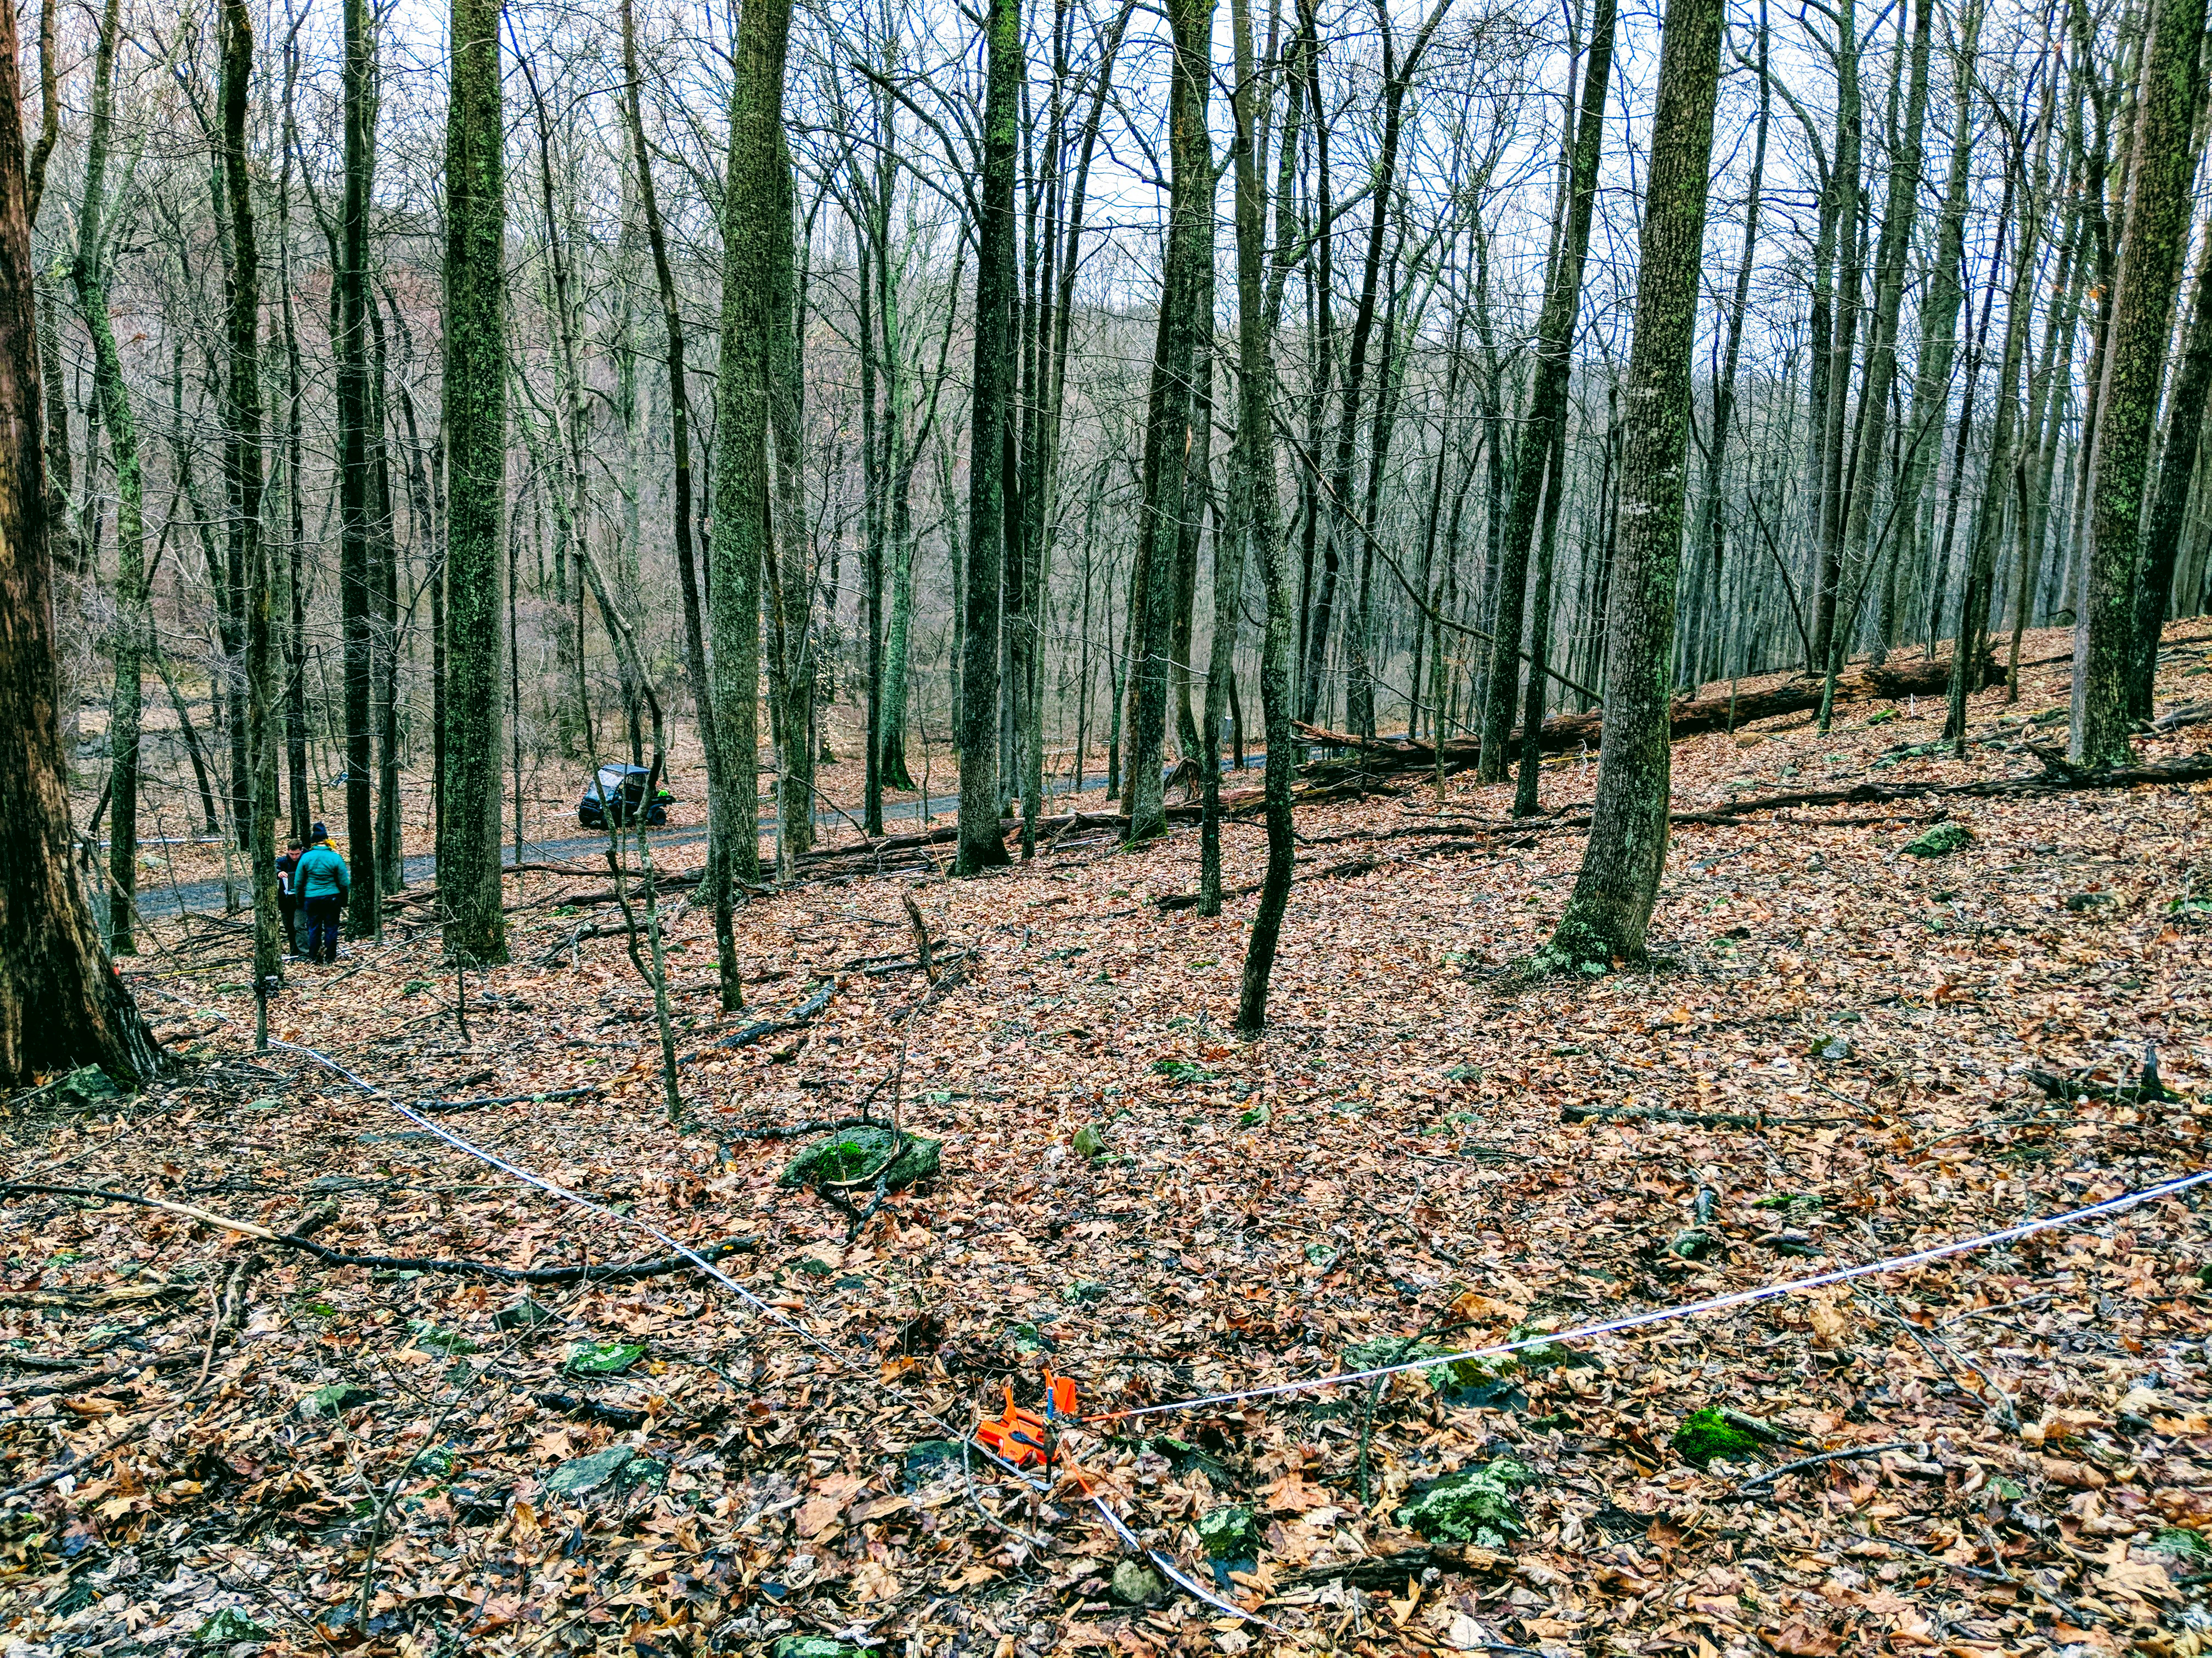
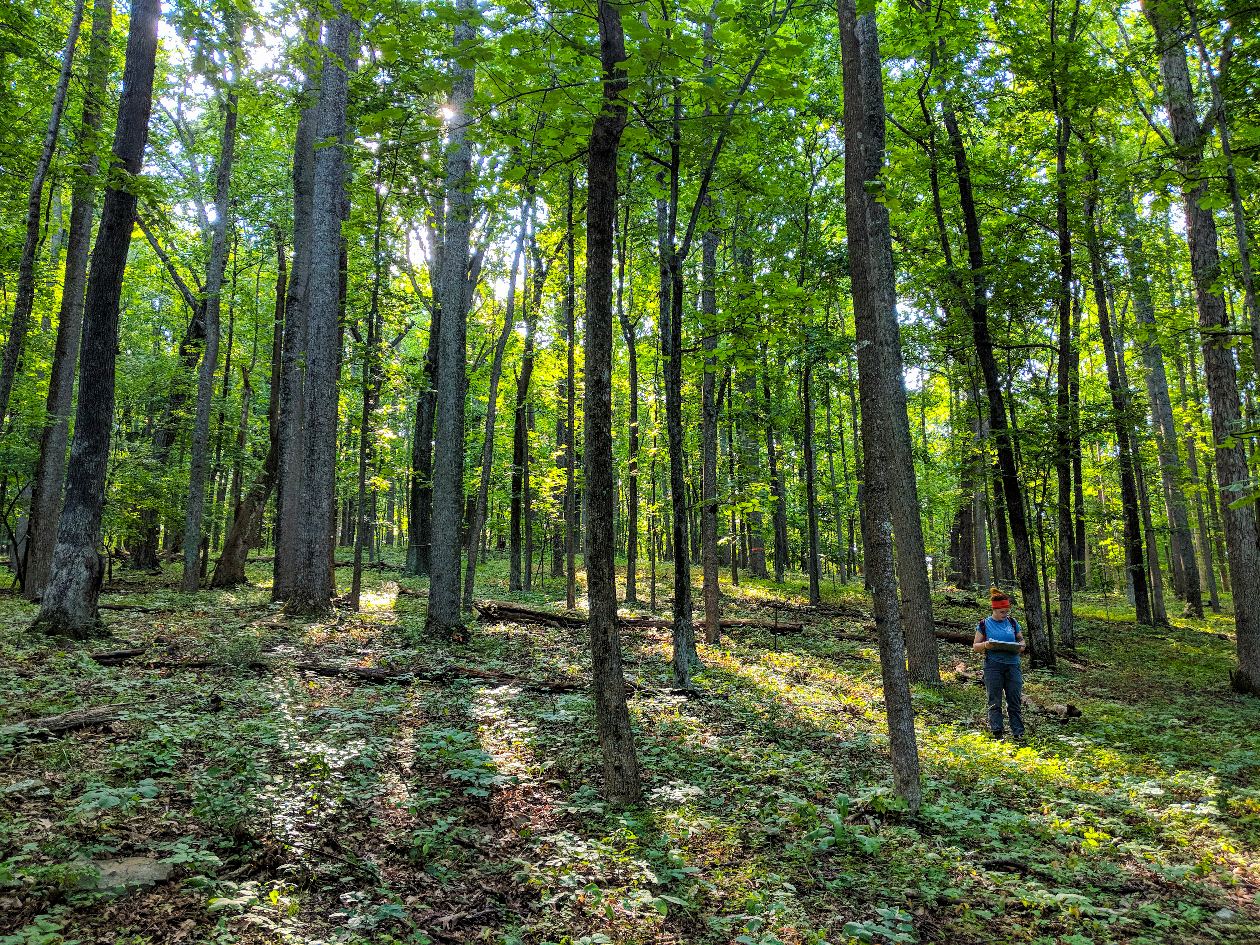
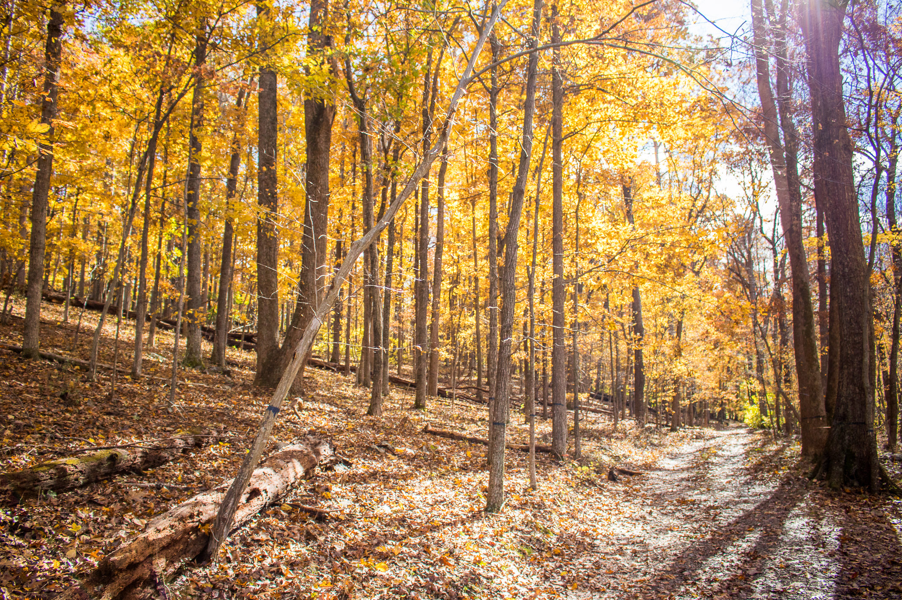
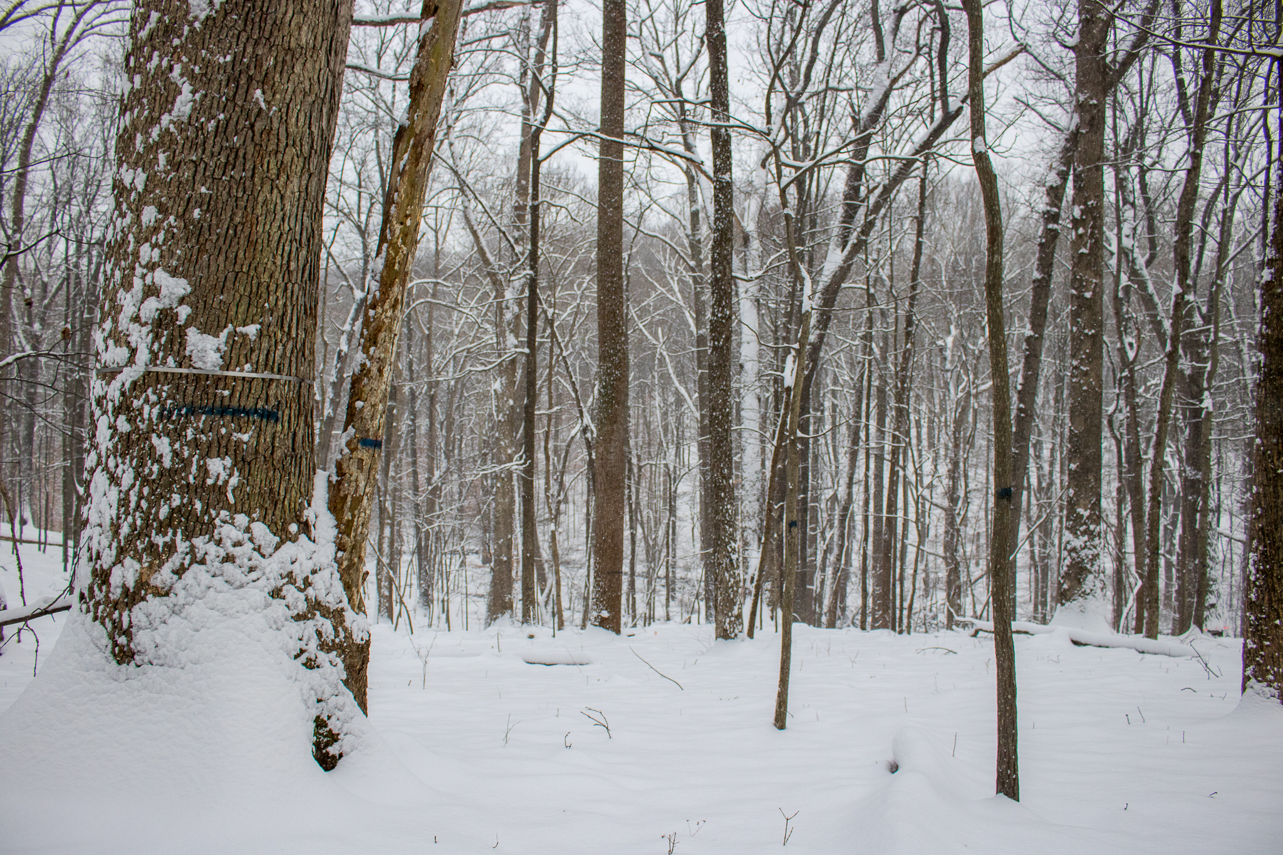
A Tree’s Life
Deciduous Forest Phenology in an Era of Global Change
Contributors: Ian McGregor, Kristina Anderson-Teixeira, Ryan Helcoski, Norm Bourg, William McShea, Erika Gonzalez, Valentine Herrmann
The Forest at SCBI
Tall Trees Grow Best! …Right?
When Attackers Come to Play
Study Plot Set-up
640 x 400m, 25.6 ha
Established 2008
ForestGEO (Global Earth Observatory)
Census every 5 years
Canopy position affects growth
Include bennet et al?
Pests and Pathogens causing mortality
Ryan’s poster
Mortality survey data?
Graphs from ForestGEO census?
How is data used and analyzed?
Species turnover
Censuses and mortality surveys
Spread of invasive plants/pests
Growth on an annual basis via dendrometer bands
Sources: (will be size 14 font later)
Some writing here indicating the vast amount of knowledge we’re using.
Gonzalez-Akre et al 2016

